Slide 1



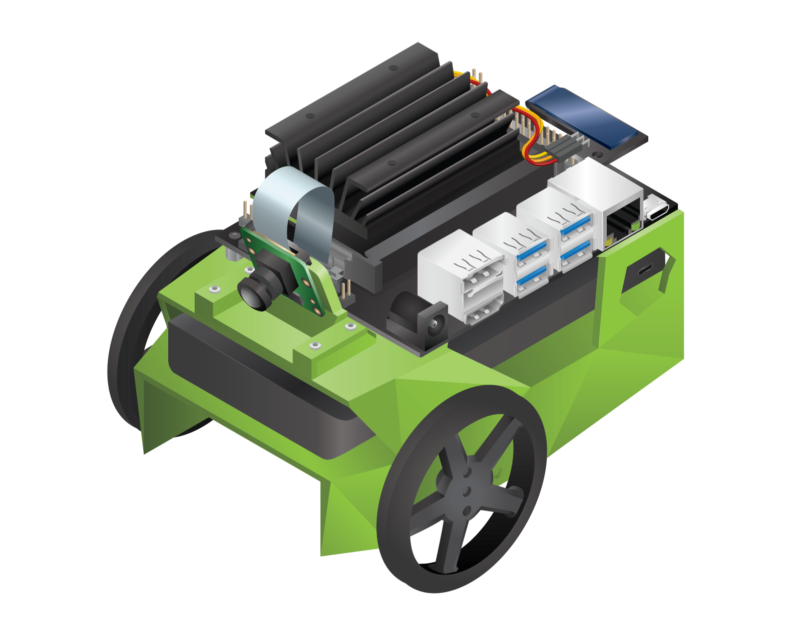
AWS
Robot
Computer (Host)

